Slide 1
Counting sets

Slide 2
Disjoint sets
Team A has 11 players
Sitting on the Bench : 8 players
Total number of players: 11 + 8 in the team

Slide 3
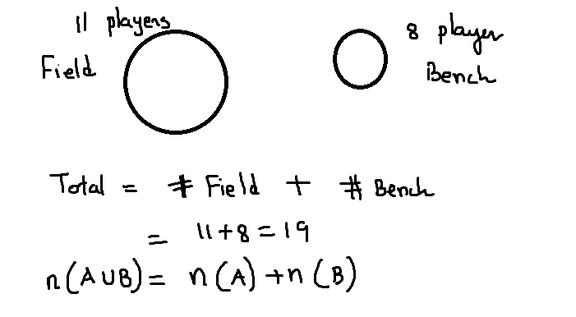

Slide 4
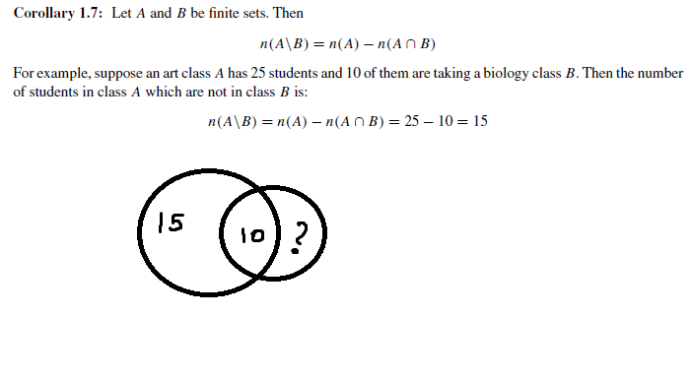
Not a disjoint set

Slide 5
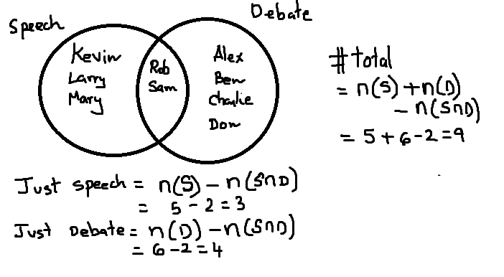
Students enrolled in speech and debate tournament.

Slide 6
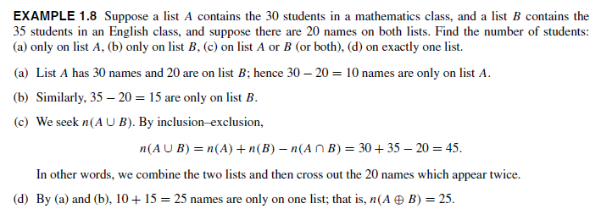
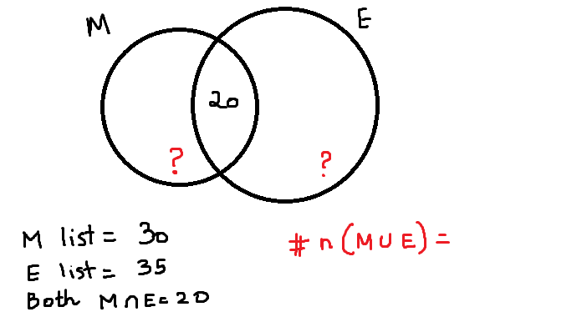

Slide 7
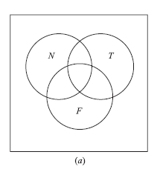
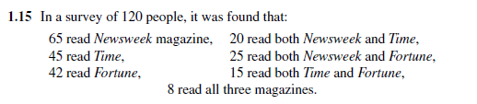

Slide 8
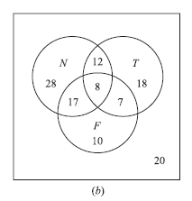

Slide 9
